Slide 1
Prediction and Classification Models for Liver Transplant Patients
BY: Bridget Hanley, Danish Rai, Sid Mehta

Slide 2
Agenda
01
Introduction and Motivation
02
Our Data
03
Research Questions
04
Preliminary Analysis
05
Models and Results
Notes:
Sid

Slide 3
Introduction and Motivation
Giving patients a better understanding of their chances of survival after they receive a transplant
No known cure for End Stage Liver Disease (ESLD) other than a transplant
Over 17,000 people on the waiting list
Notes:
Sid
A liver transplant is a surgical procedure that removes a liver that no longer functions properly and replaces it by a deceased donors healthy liver or a portion of a living donor's healthy liver.
With such a large number, giving patients a better understanding of where they stand can help them make better choices.

Slide 4
Data
Scientific Registry of Transplant Recipients (SRTR)
1987-2018
404 variables, 292,489 observations before data preparation and cleaning
47 variables and 46,600 observations after data preparation and cleaning for 2002-2018
Notes:
bridget
the data we obtained came from the scientific registry of transplant recipients and it ranges from the years 1987-2018. originally it had 404 variables and over 200,000 observations. Based on our research questions, we only needed to include variables that pertained to the recipient and donors health and size, so we narrowed it down to 47 variables. Since the data set goes back so far and has so many variables we had to do a lot of filtering in our data set. For example, we got rid of pediatric patients and only looked at years 2002 and above since the MELD score was introduced in 2002. After all of our filtering, we were left with 46,600 observations.

Slide 5
Preliminary View of Key Variables
Organ Procurement Organizations (OPO): is a non-profit organization that is responsible for the evaluation and procurement of deceased-donor organs for organ transplantation.
Region: 1 to 11
MELD/PELD scores: Model of End Stage Liver Disease/ Pediatric End-stage Liver Disease
range: 6 to 40
Higher the score, the higher the severity.
Donor/ Recipient Demographic information
Blood type, Age, Height, BMI, Cause of Death, Deceased History of (Alcohol, Cigarettes, and Cocaine use), Type (Deceased or Living), Ethnicity
Notes:
Danish

Slide 6
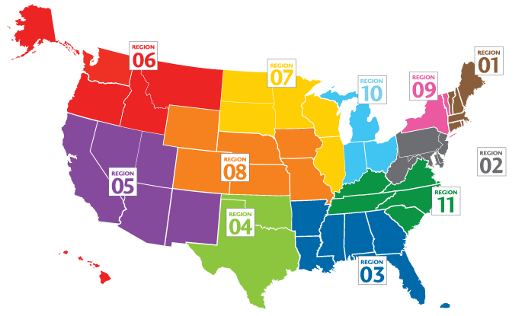
Regions 1 -11
Notes:
Danish

Slide 7
Research Questions and Practical Implications
Quantitative:
Can we predict survival time for patients one-year after receiving a transplant?
Qualitative:
Classifying if a patient survived one-year after receiving a transplant.
Help patients get a better idea of their chances of survival for a prolonged time after a year of transplant
Notes:
Danish
helps doctors give patients a better idea of their placement on the list and helps the patients make better decisions

Slide 8
Data Intervals
Study by American Liver Foundation shows that about 75% of the patients survive one to five years after receiving a transplant.
The Data was divided in two intervals:
1 to 3 Years Survival Time
1 to 5 Years Survival Time
Quantitative and Qualitative Models were generated for both intervals
Notes:
Danish

Slide 9
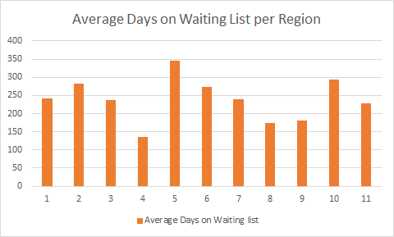
Waiting Time per Region
Region 4 has the lowest avg. waiting time.
Region 5,10,2 have the highest Waiting Time
Notes:
Sid

Slide 10
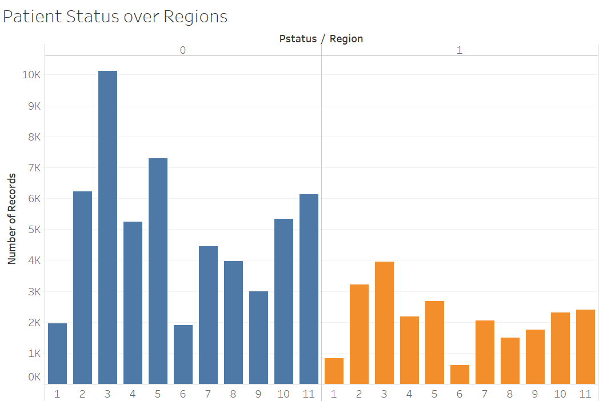
Patient Status Over Region
Region 3 has the highest patient death and survival in records.
Region 6 has the lowest patient death and survival in our records.
Notes:
bridget
So patient status tells us whether the patient is alive or dead after their transplant. Here we see the distribution of alive (1) or dead(0) across all regions. If you notice, you'll see that region 3 has the highest number of deaths after transplants by a good margin, and so we looked into what states are in this region and the different health factors over this region as well. Region 3 consists of Alabama, Arkansas, Florida, Georgia, Louisiana, Mississippi, and Puerto Rico. region 3 also has the highest number of recipients with diabetes, the graph here is only showing type 2 diabetes since it is the most severe but even when you consider all types of diabetes it still has the highest rate. Therefore, it is not very surprising to us that region 3 is experiencing the most deaths after a transplant, because diabetes mixed with ESLD can cause a lot of health issues, even if you get a a transplant successfully done.

Slide 11
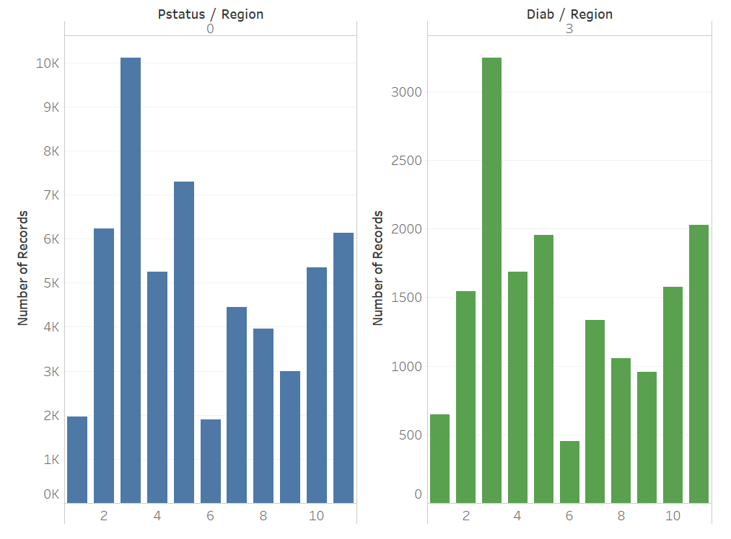
Diabetes Type 2 Over Region
Region 3 has highest number of deceased patients who were also diagnosed with Type 2 diabetes
Notes:
bridget

Slide 12
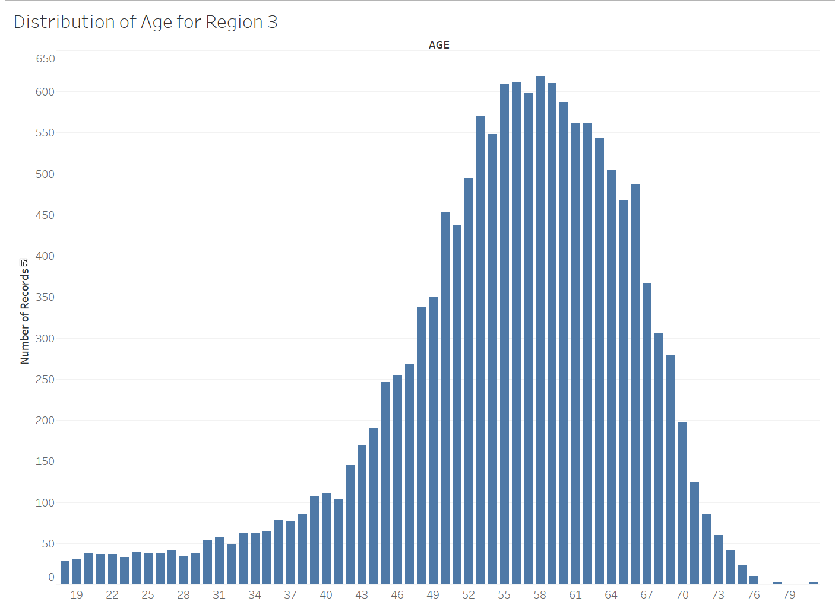
Age Distribution for Region 3
Region 3 has patients with an elderly population
Notes:
bridget

Slide 13
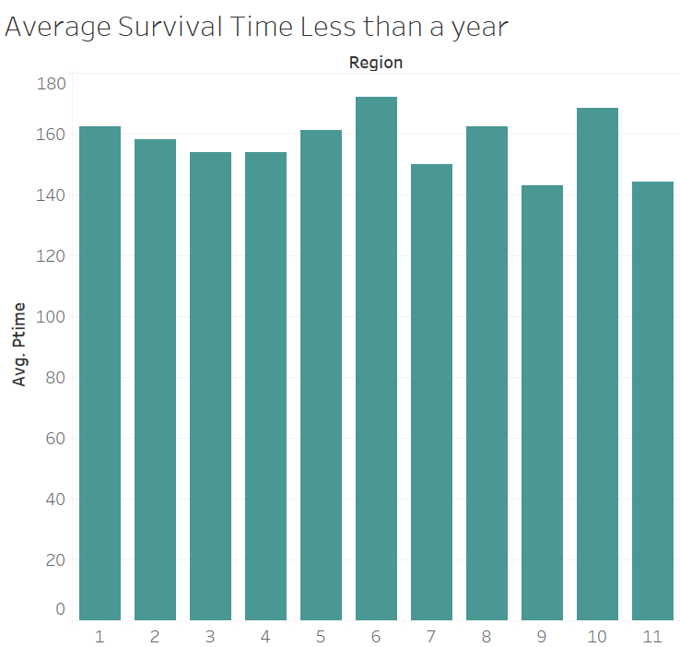
Patient Survival Time Over Region (< Year)
Region 6 has the highest average patient survival time in days after Liver Transplant
Region 9 has the lowest average patient survival time in days after Liver Transplant.
Notes:
Danish

Slide 14
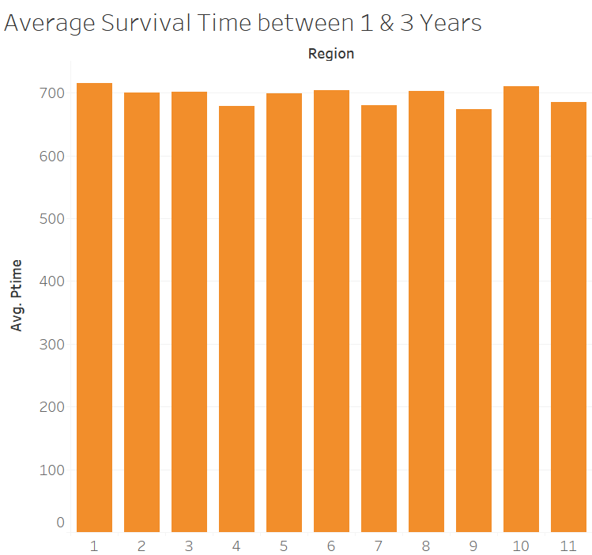
Patient Survival Time Over Region (1-3 yrs)
Region 1 has the highest average patient survival time between years one and three.
Region 9 has the lowest average patient survival time between years one and three.
Notes:
Danish

Slide 15
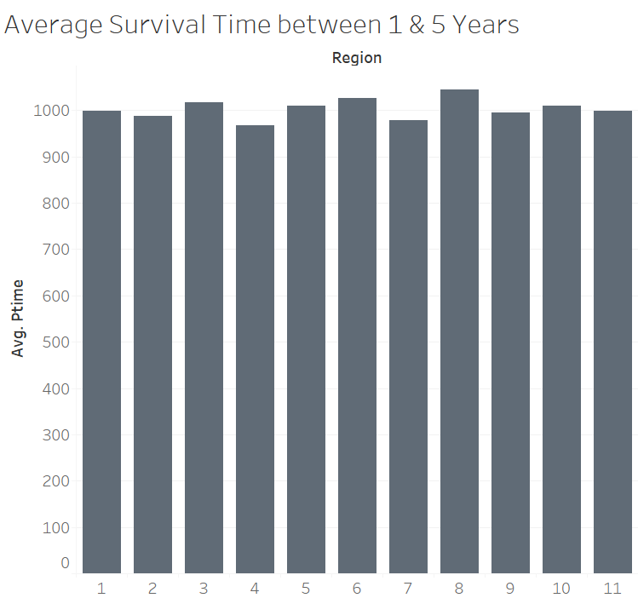
Patient Survival Time Over Region (1-5 yrs)
Region 8 has the highest average patient survival time between years one and five.
Region 3 has the lowest average patient survival time between years one and five.
Notes:
Danish

Slide 16
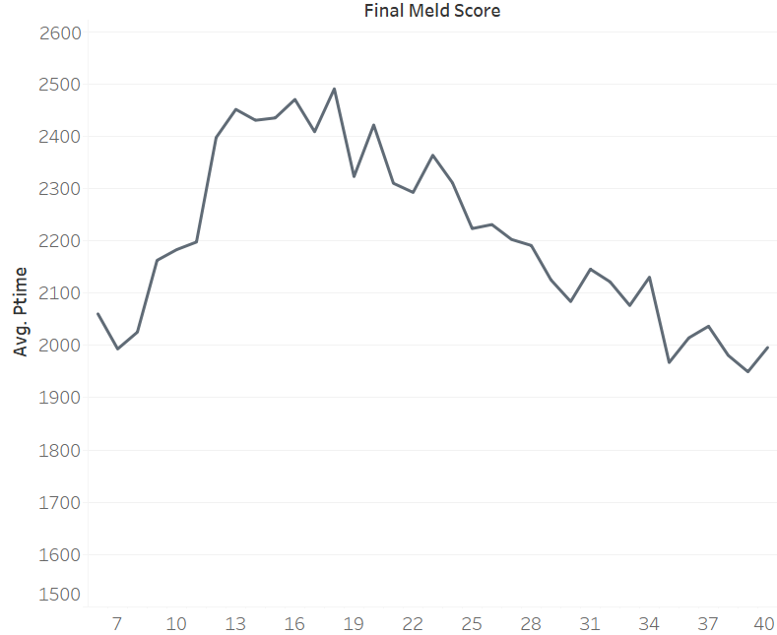
PTIME over MELD Score
Patients who had a very High or very Low MELD score at the time of the transplant, had a very low Average survival time
Notes:
Sid

Slide 17
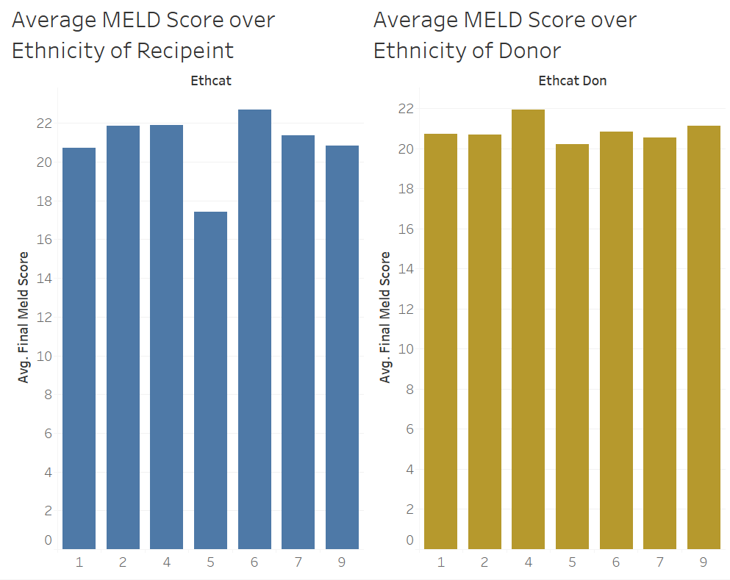
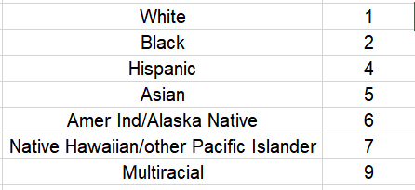
MELD Score over Ethnicity
Hispanic patients have the lowest avg. MELD score.
American Indians/ Alaska Native have the highest MELD Score
Notes:
Sid

Slide 18
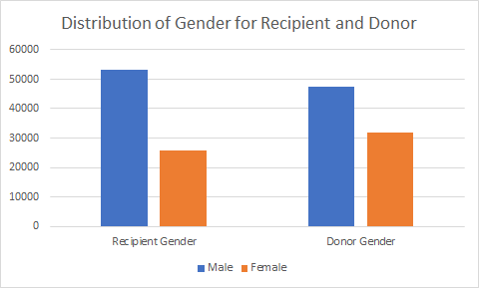
Distribution of Gender for Recipient and Donor
There are less female donors than male donors
Notes:
Bridget
here we see the distribution of gender across the recipients and donors, and you can see that its very obiously uneven, and something that we will get into later is that gender plays a sigificant role in liver size and with such an uneven distribution of genders this can make it harder to find matches for transplant.

Slide 19
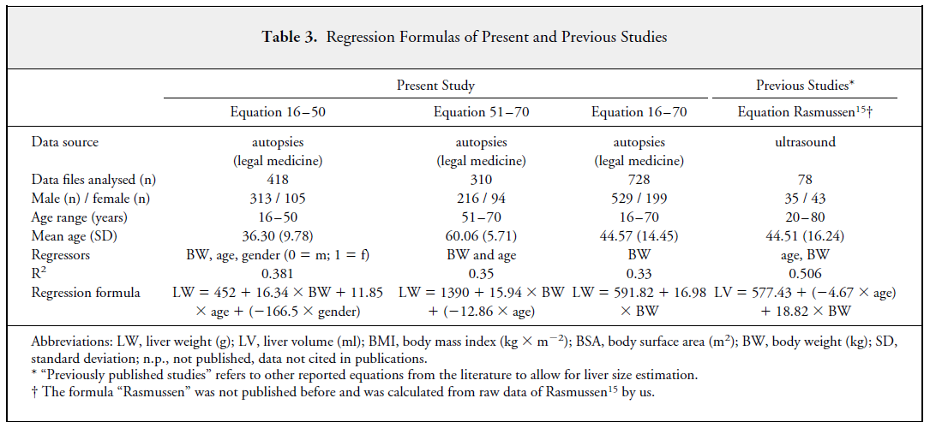
Calculating Liver Size
Notes:
Bridget
Bridget
something that we did in an attempt to improve our models accuracy was make a new variable for recipients liver size and donors liver size. When it comes to liver transplants, the thing that makes the biggest difference in matching recipients and donors is their size, which ultimately correlates to their liver size. Through a lot of research we found an article that used this formula to calculate liver size for different age ranges. We applied this formula to our data to create a liver size variable to include in our models and we also have a chart that shows the distribution of this liver size variable for both the recipient and the donor across all the regions. If you notice the blue columns, which indicate donor liver size, are larger than the recipients liver size. since liver size is a big factor in determining transplant matches, this discrepancy can lead to a lot of issues when matching recipeints and donors.

Slide 20
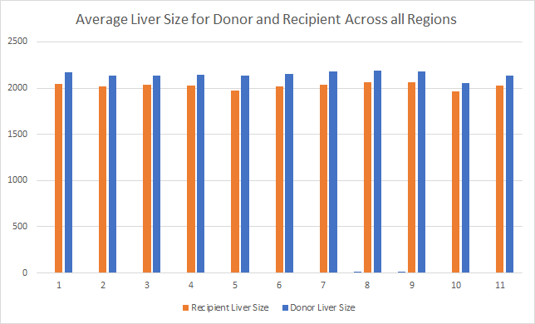
Donor and Recipient Liver Size Per Region
Donor Liver size is larger in all regions, making it harder to find matches
Notes:
Bridget

Slide 21
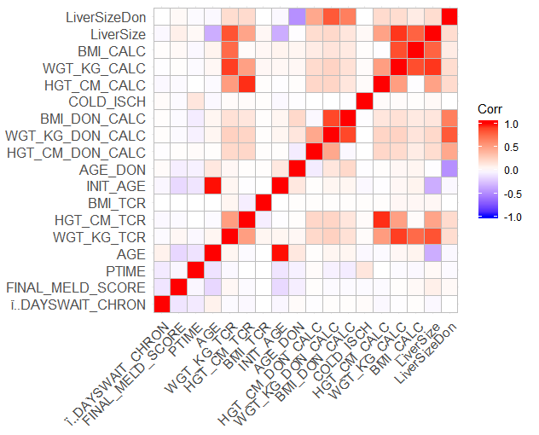
Correlation Heatmap
Strong correlation between:
Liver Size and Weight
BMI and Weight
Liver Size and Age
Mostly low to no correlation between the variables
Notes:
Danish

Slide 22
Linear Models
Variables Included to Predict Patient Survival Time:
MELD Score
Region
Recipient and Donor liver size (includes body weight, gender, and age)
Alcohol Heavy Donor
Transplant Year
Notes:
Danish

Slide 23
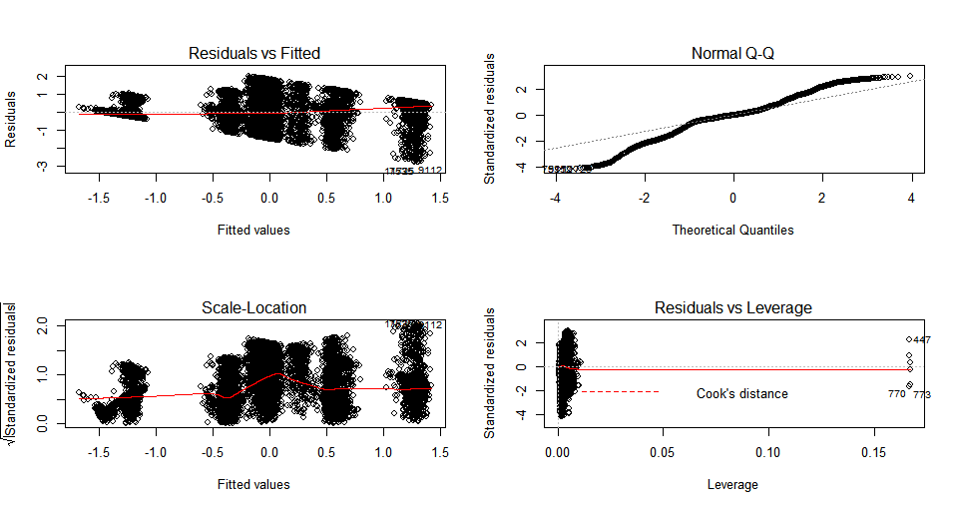
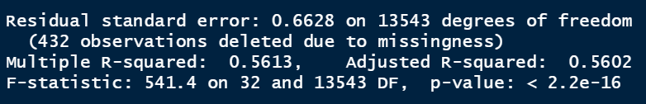
Linear Regression Models (1-3 yrs)
Adjusted R-Squared: 0.56
RSE: 0.66
The Residual vs Leverage plot shows there are out outliers in the data set
No Sign of Leverage
Low ME and MAE
Notes:
Danish

Slide 24
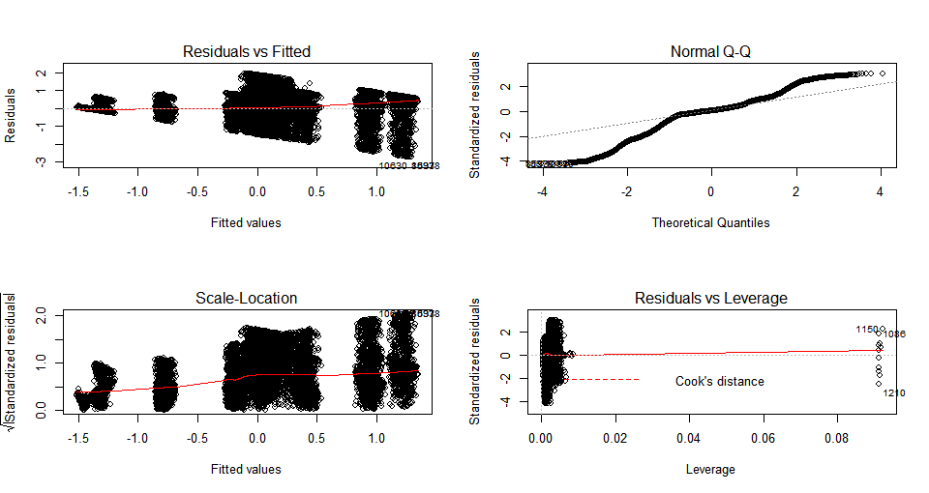
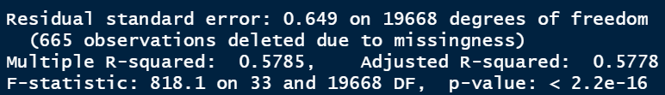
Linear Regression Models (1-5 yrs)
Adjusted R-squared: 0.5778
RSE: 0.649
The Residual vs Leverage plot shows there are out outliers in the data set
No Sign of Leverage
Notes:
Danish

Slide 25
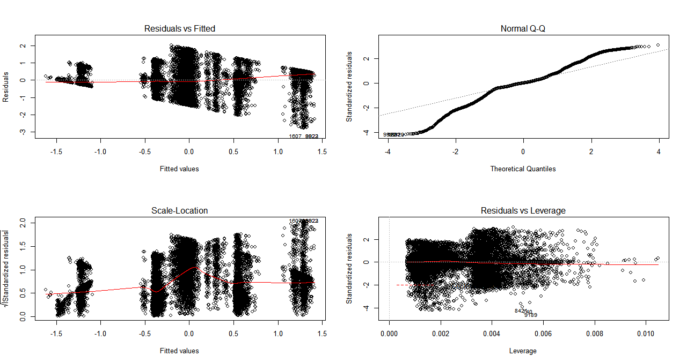
Linear Regression Models (1-3 yrs)
After outliers are removed, the Residual vs Leverage plot is more spread out, however, no changes in the model performance
Notes:
Danish

Slide 26
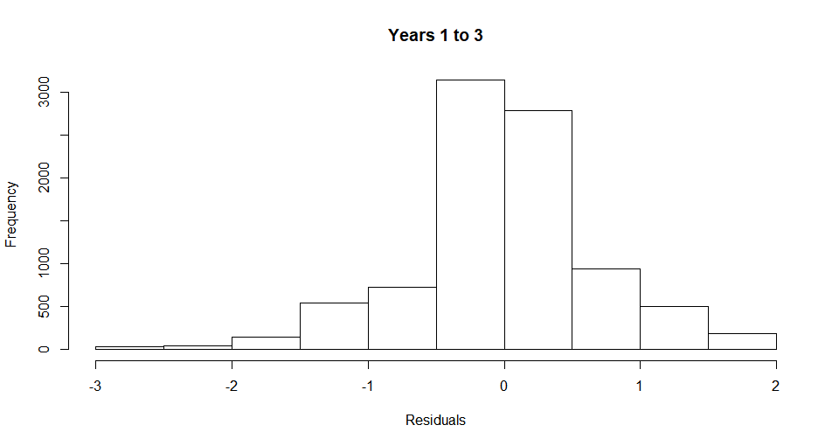
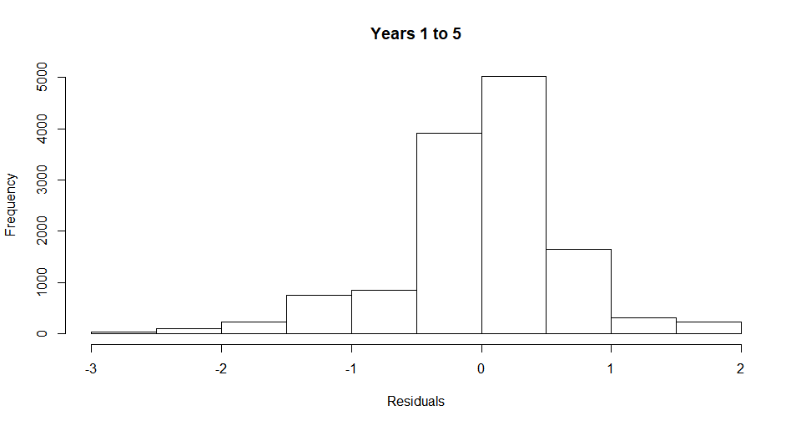
Validation Distribution
Notes:
Danish

Slide 27
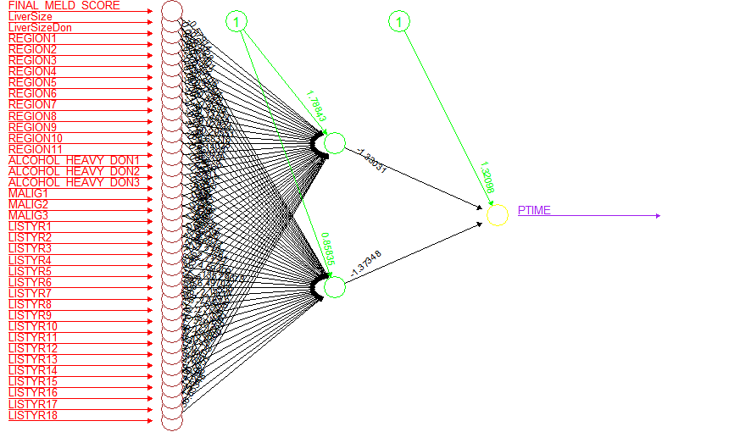
Neural Network (1-3 yrs)
Very low ME and High RMSE.
Under predicts
Notes:
Danish

Slide 28
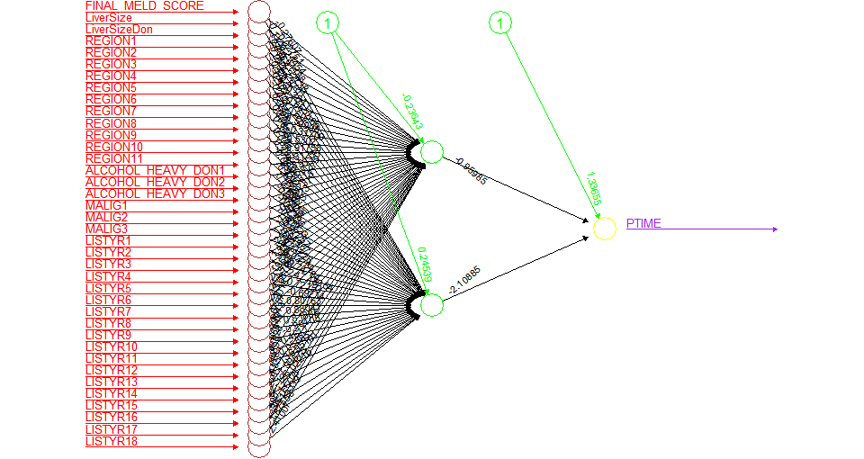
Neural Network (1-5 yrs)
Very low ME and High RMSE.
Under predicts
Notes:
Danish

Slide 29
Classification Models
Variables Included to Predict Patient Status:
MELD Score
Diabetes in the donor and Recipient
Region
Recipient medical condition at time of transplant
Recipient and donor height
Recipient and Donor liver size (includes body weight, gender, and age)
Gender Match (indicated whether recipient and donor were of the same gender)
Notes:
(BRIDGET) For our classification models, we wanted to predict the patient's status 3 years and 5 years after their transplant. Since we are predicting the patient status, we wanted to include variables that pertained to both the patient and the donor. Specifically, we wanted variables that indicated the patient and donors size, as well as the liver quality since these variables are important in determining matches for transplants and ultimately transplant success. We

Slide 30
Impact of Blood Type Variable
 | without blood type match | with blood type match
Logistic | 71.52 | 71.39
LDA | 71.56 | 71.32
Notes:
(BRIDGET) In addition to the variables we just discussed that we included, we also played around with including blood type in our classification models. In our research, we found that blood type isnt very significant when matching a recipient to a donor. You don’t need an exact match when it comes to liver transplants, you just need the blood types to be compatible. We ran some models with a variable called blood type match, which is an indicator of how well the blood types of the recipient and donor match. Overall, we found that this variable did not improve the results of the model, and in the instance we have above, the accuracy actually decreases slightly. This finding was consistent with the rest of our models, we just wanted to give you guys an idea of how our model reacted to this variable and why we choose not to include it in these models.

Slide 31
Logistic
 | 3 year | 5 year
Validation Classification | 71.52 | 71.63
Notes:
(BRIDGET)
for our logistic model, we got validation errors of 71.52% for 1 - 3 years survival time and 71.63% for 1-5 years survival time

Slide 32
LDA & QDA
 | 3 year | 5 year
Validation for LDA | 71.56 | 71.59
Validation for QDA | 70.81 | 71.56
Notes:
Bridget
between LDA and QDA, lda predicted patient status better than QDA with an error of 71.56% for 3 year survival time and 71.59% for 5 year survival time

Slide 33
Neural Network
 | 3 year | 5 year
1 Hidden layer 2 Nodes | 71.4 | 71.21
1 Hidden layer 3 Nodes | 71.11 | 71.46
Notes:
Bridget
for our neural networks, we ran two different structures. first with one hidden layer and two nodes, and then with 1 hidden layer and 3 nodes. Both structures gave around the same accuracy but for 3 years survival time, the network with 1 hidden layer and 2 nodes gave the best accuracy with 71.4% and then for 5 years the network with 1 hidden layer and 3 nodes gave the best with 71.46%

Slide 34
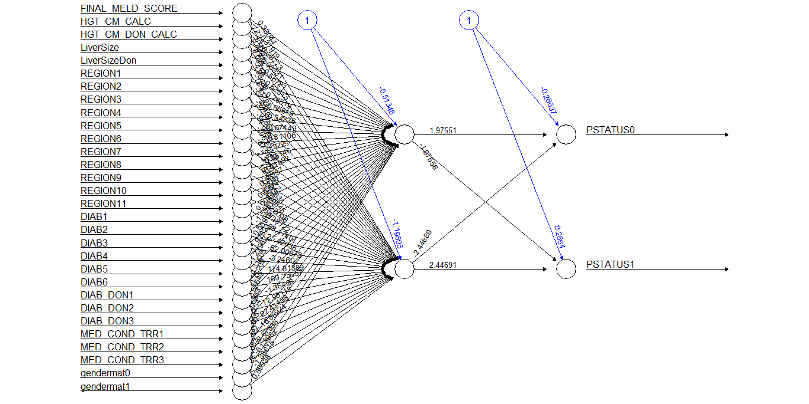
Notes:
best nn for predicting 3 years

Slide 35
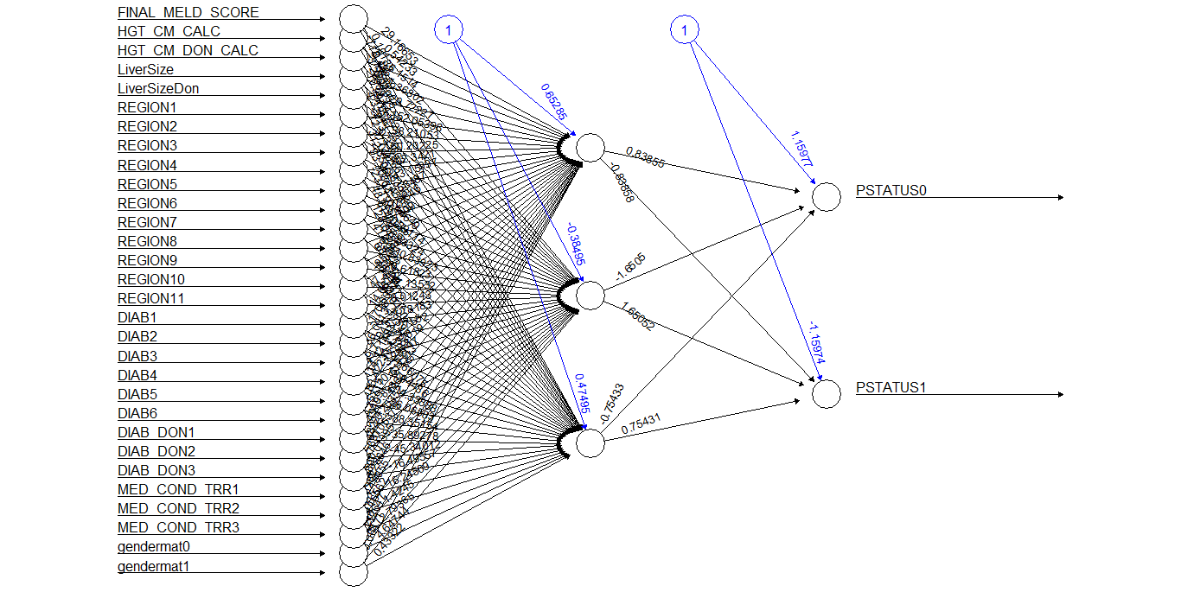
Notes:
best NN for predicting 5 years

Slide 36
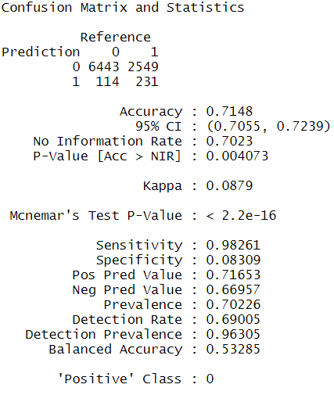
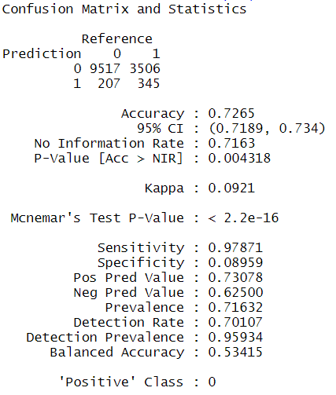
Naive Bayes
PATIENT SURVIVAL AFTER ONE TO THREE YEARS AFTER SURGERY
PATIENT SURVIVAL AFTER ONE TO FIVE YEARS AFTER SURGERY
Notes:
Sid

Slide 37
Random Forest
 | 1-3 years | 1-5 years
Validation Classification | 71.22 | 72.54
Notes:
Sid

Slide 38
Classification Comparison
 | 1-3 years | 1-5 years
Logistic | 71.52 | 71.63
LDA | 71.56 | 71.59
QDA | 70.81 | 71.56
NN 1 layer 2 nodes | 71.4 | 71.21
NN 1 layer 3 nodes | 71.11 | 71.46
Naive Bayes | 71.48 | 72.65
Random Forest | 71.22 | 72.54
Notes:
Sid

Slide 39
Conclusion
Quantitative:
Can we predict survival time for patients one-year after receiving a transplant?
Yes, we are able to predict patient survival time using linear regression and predictive variables such as Liver Size, MELD Score, Region and Transplant Year.
Qualitative:
Classifying if a patient survived one-year after receiving a transplant.
We are able to predict a patient's survival status successfully for 1-3 years and 1-5 years after a transplant with good accuracy using LDA for 1-3 years and Naive Bayes for 1-5 years
Notes:
Danish

Slide 40
Thank you!
Any questions?

